Slide 1
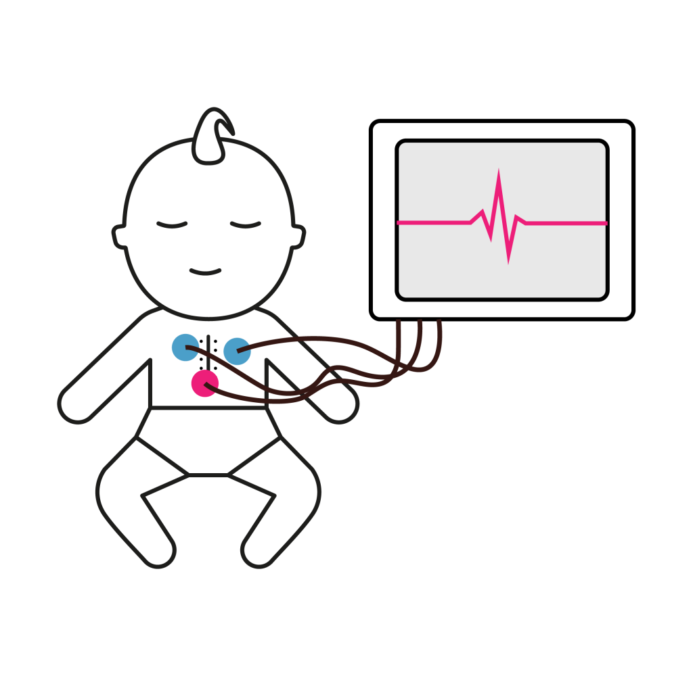
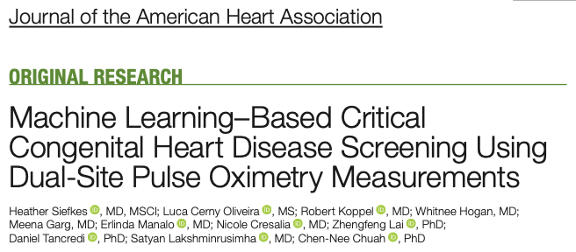
Neonatal Journal Club Anoop Ramana 24th Jan 2025

Slide 2
Background
Current CCHD screening relies primarily on oxygen saturation (SpO2) measurements.
SpO2 screening alone misses a significant number of CCHD cases, especially coarctation of the aorta (CoA).
Additional pulse oximetry features, such pulse delay and repeated data points, may improve detection.
Notes:
We all know that CCHD screening is vital for early detection of life threatening conditions. However, relying solely on oxygen saturation (SpO2) has its limitations. A significant number of cases, particularly those with coarctation of the aorta (CoA), are missed by standard SpO2 screening123. This is not due to a failure of the screening itself, but because these conditions don't always cause an obvious drop in SpO21. This is a problem because late detection increases morbidity and mortality456. We need to move past a single data point, a snapshot in time, and adopt a more comprehensive, holistic approach, that reflects our movement toward a more whole patient perspective.

Slide 3
Study Objectives
Develop a machine learning algorithm that uses pulse oximetry data to improve CCHD detection.
Evaluate different ML models using various pulse oximetry features such as SpO2, perfusion data, and pulse delay.
Determine the optimal timing and measurements for enhanced CCHD screening.
Notes:
The objectives of this study were to see if a machine learning (ML) approach, combining SpO2 with other physiological data, could improve CCHD detection7. We were specifically looking to improve the detection of CoA, which is frequently missed with SpO2 alone17. The goal is to move beyond the limitations of the current screening by using data-driven innovation to enhance clinical care8. We wanted to see if technology could help us identify those babies we might otherwise miss with our current methods

Slide 4
Methods - Study Design
• Six-site prospective study involving 523 newborns.
(317 without CHD, 132 with CCHD, including 21 with isolated CoA)
• Intervention: Dual pre- and post-ductal pulse oximetry measurements at 0–24 hours, 24–48 hours, and >48 hours.
• ML models integrated SpO₂, perfusion index, and radio-femoral pulse delay.
• Compared single and dual time-point models with/without pulse delay.
• Outcome Measures: Sensitivity, specificity, AUROC for CCHD and CoA detection.
Notes:
This was a multi-site prospective cohort study9. By including six different centers we aimed to capture the broad range of clinical presentations and make our results generalisable9. This is critical to ensure that our research findings can be applied across various healthcare settings. We enrolled both newborns with and without CCHD, allowing for a comprehensive analysis of the effectiveness of our approach.

Slide 5
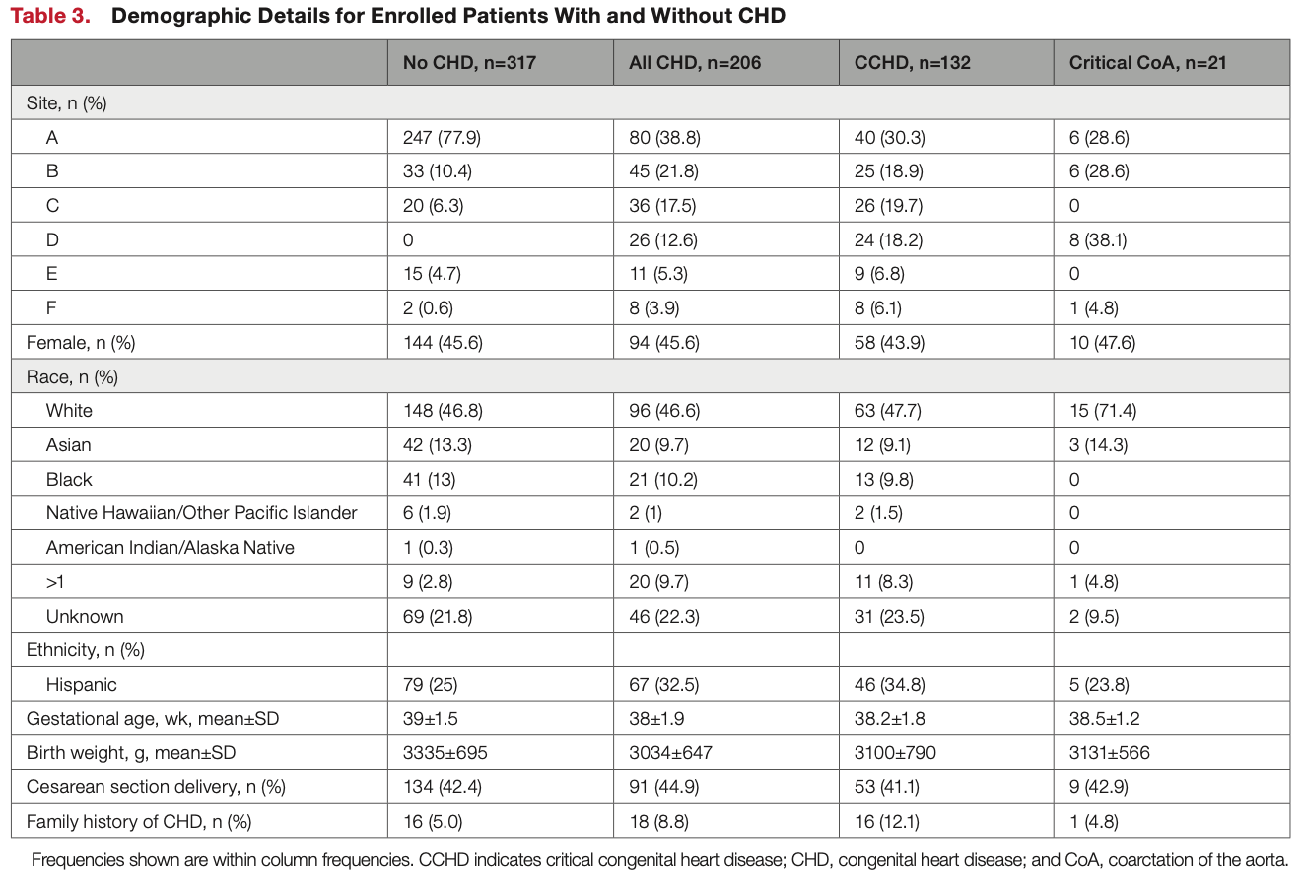
Methods - Participants
Total: 523
317 without CHD
206 All CHD
- 132 with CCHD
- 21 with isolated CoA

Slide 6
Methods - Data Collection & Processing
Data collected using two pulse oximeters connected to a computer.
Pulse oximetry waveforms were analyzed for SpO2, pulse amplitude index (PAI), and pulse delay.
A machine learning algorithm was used to detect and remove motion artifacts.
Notes:
We used a dual-site pulse oximetry system to record SpO2, perfusion data and pulse waveforms from both the right hand and a foot.10. These waveforms were captured by a computer with a Raspberry Pi, which allowed us to collect and analyse far more data than we could ever do manually10. A key part of the process is to remove artefactual data. Our machine learning based algorithm identifies motion and other artifacts and removes them, ensuring the validity of the data used for our analysis1112. This use of technology allows for a deeper and more consistent level of data analysis than is achievable by observation alone

Slide 7
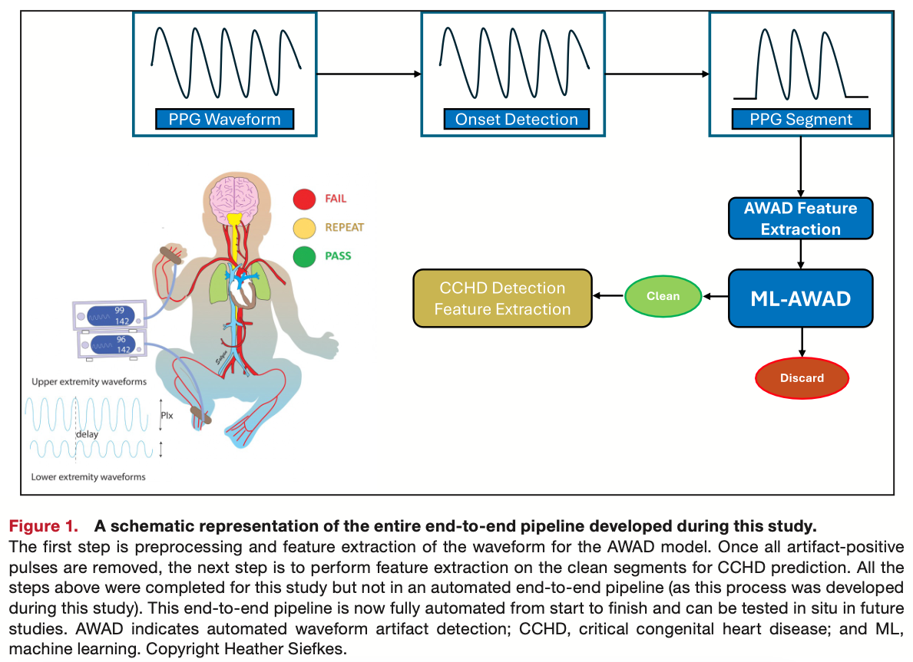
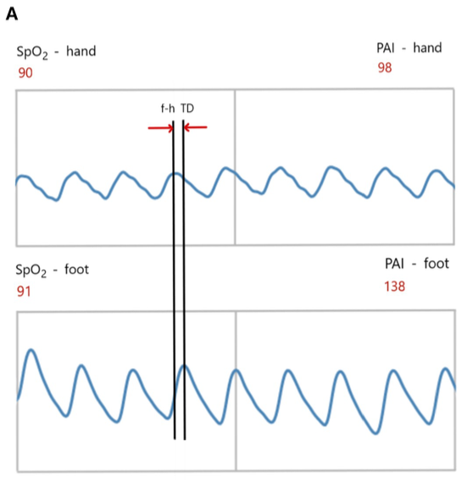
Methods - Data PIPELINE

Slide 8
Methods - Machine Learning Models
The study evaluated models at 1 and 2 time points, with and without pulse delay.
Various machine learning models were tested such as logistic regression, random forest, gradient boosting, decision trees, and XGBoost.
Feature selection techniques were used to optimize model performance.
Notes:
We used several machine learning models to analyse the data. We selected and tuned the features in our models, including SpO2, perfusion index and the radiofemoral pulse delay. We did this over 5-folds to make sure we achieved an optimal and robust model13. We explored different models and also tested the models with and without pulse delay and at 1 and 2 timepoints to see which models had the most power14. These features provide a much more nuanced picture compared to simple SpO2 values alone815. Think of this approach as how a statistician might approach a complex clinical problem and the machine learning models are the tools they are using for the data analysis. For example, pulse delay was included in the model because it helps to identify coarctation of the aorta by demonstrating differences in blood flow from the heart to the hand compared with the foot

Slide 9
Results - Improved CCHD Detection
The 2-time point model with pulse delay had the best performance.
Sensitivity for CCHD detection improved to 92.86% compared to 71.43% with SpO2 alone.
Sensitivity for CoA detection improved from 0% to 66.67%.
All ML models achieved 100% specificity.
Notes:
Our results show a clear improvement in CCHD detection with the machine learning approach14. Using the 2-time-point model with pulse delay, we increased the detection of CCHD from 71% with SpO2 alone to over 92%. And importantly, we significantly improved the detection of CoA14. Remember, this is not just a number; this represents real lives. An increase in detection by around 20% with machine learning translates to a higher rate of saving newborns with CCHD from morbidity and mortality associated with late diagnosis

Slide 10
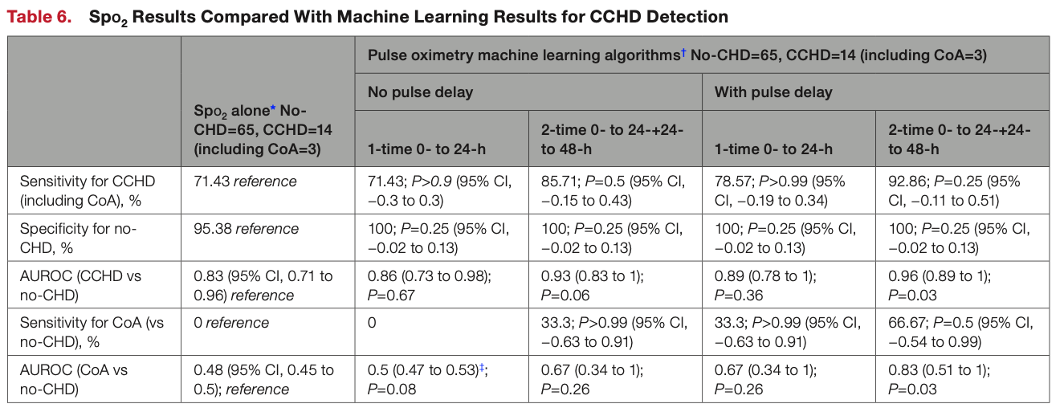
Results - Statistical Significance
AUROC for CCHD detection improved from 0.83 to 0.96.
AUROC for CoA detection improved from 0.48 to 0.83.
The improvement in AUROCs was statistically significant (P=0.03) for both CCHD and CoA.
Notes:
To quantify the clinical utility of our new model, we used the Area Under the ROC curve (AUROC). The closer the area is to 1.0, the more useful a test is to distinguish between disease and no disease. SpO2 alone had an AUROC of 0.83 for CCHD, but we saw significant improvement with machine learning, especially for CoA, increasing from 0.48 to 0.8314. The AUROC for CCHD detection increased from 0.83 to 0.96 with our best performing model14. Using the visual representation of the ROC curve, we can easily see the trade off between sensitivity and specificity with each approach. This demonstrates the improved accuracy of our machine learning model in identifying CCHD and CoA.

Slide 11
Results - Prenatally Suspected CoA
All ML models correctly classified healthy infants with prenatally suspected CoA.
This suggests the potential to reduce unnecessary NICU admissions for these infants.
Further validation is needed before this can be used clinically.
Notes:
Importantly, our ML models correctly classified all ten infants with prenatally suspected CoA who were later found to be healthy16. This is a significant finding as it suggests that our model could help reduce unnecessary admissions and investigations in babies with suspected CoA17. Reducing unnecessary NICU admissions reduces harm and is an example of the ALARA principle, a principle that asks us to keep radiation exposure As Low As Reasonably Achievable. These results suggest that machine learning could potentially reduce stress for families and allow resources to be directed to babies that really need them.

Slide 12
Discussion - Implications
ML-based pulse oximetry has the potential to improve early detection of CCHD, especially CoA.
This could lead to earlier intervention and better outcomes for affected infants.
The algorithm uses readily available data, making it potentially feasible for routine screening.
Notes:
These findings have significant implications for clinical practice. Earlier and more accurate detection of CCHD and CoA means that we can intervene sooner5. This improved detection can lead to better outcomes, reduced morbidity, and potentially shorter hospital stays. By reducing the number of missed diagnoses, we can improve overall care for newborns with CCHD and CoA, and provide better outcomes for our patients18. All of this leads to better care centered around our patients’ needs.

Slide 13
Discussion - Limitations
The sample size for ML development and testing was small.
The model needs to be validated in larger, diverse cohorts.
The study did not account for skin pigmentation, a concern for pulse oximetry accuracy.
Notes:
Like all research, our study has its limitations. The sample size was relatively small, especially the number of patients with CoA, although the sample did achieve an increased AUROC for both CCHD and CoA detection19. Also, we did not collect data on skin pigmentation, which is an important limitation as we know that pulse oximetry is less accurate in patients with darker skin192021. We need to address this to reduce health disparities, because these findings cannot be generalised without ensuring diverse populations are included. These limitations represent opportunities for future research, and are areas that we are currently working on19.

Slide 14
Conclusion
Machine learning applied to dual-site pulse oximetry may improve CCHD screening.
The use of perfusion data and pulse delay, along with SpO2, increases detection sensitivity.
Further research is needed to validate these findings and ensure clinical applicability.
Notes:
In conclusion, this machine learning approach shows promise for transforming how we screen for CCHD. By combining physiological data, we can move towards more accurate and efficient screening that leads to early detection, improved outcomes and reductions in length of stay. We are now inviting you to consider how this may transform the way we practice neonatal medicine in the future and how you can participate in this important area of research. Thank you.

Slide 15
Summary
Study Objectives: To investigate whether machine learning can improve CCHD, especially CoA, detection when applied to dual-site pulse oximetry measurements.
Methods: Multi-site prospective cohort study with dual-site pulse oximetry. Use of machine learning models, feature selection, artifact removal.
Results: Significantly improved CCHD detection using the 2-time point pulse delay model. Better identification of infants with CoA and good classification of healthy infants with a prenatal suspicion of CoA.
Discussion: Clinical implications of early and more accurate detection, including improved patient outcomes and reduced length of stay. Limitations of the study (small sample size, lack of diverse population) and the need for further validation.
Conclusion: Machine learning has significant potential to transform CCHD screening.

Slide 16
CHD
CHD happens in about 8 babies out of every 1,000 (0.8%).
There are 3 main types of CHD. They are conditions that affect the:
structure of the baby’s heart
function of the heart
rhythm of the heartbeat
Up to a quarter of babies (25%) with CHD have critical CHD.
Seven critical CHDs most likely detected by screening‎: hypoplastic left heart syndrome, pulmonary atresia, tetralogy of Fallot, total anomalous pulmonary venous return, transposition of the great arteries, tricuspid atresia, and truncus arteriosus.
In UK we screen for CHD at the 20-week scan (between 18+0 to 20+6 weeks of pregnancy). Sometimes we notice it during earlier or later scans in pregnancy. Not all heart conditions can be seen before the baby is born.

Slide 17
Machine Learning in healthcare
Machine Learning
A family of statistical and mathematical modelling techniques that uses a variety of approaches to automatically learn and improve the prediction of a target state, without explicit programming techniques that uses a variety of approaches to automatically learn and improve the prediction of a target state, without explicit programming; without using hypothesis based assumptions
Notes:
WHY?
- Healthcare systems are trying to improve delivery and access to high quality care and achieve optimal outcomes for patients.
All the while simultaneously trying to reduce the accompanying unsustainable costs and burnout in healthcare providers.
Machine learning in healthcare holds a great deal of promise for helping us achieve these perennial goals.

Slide 18
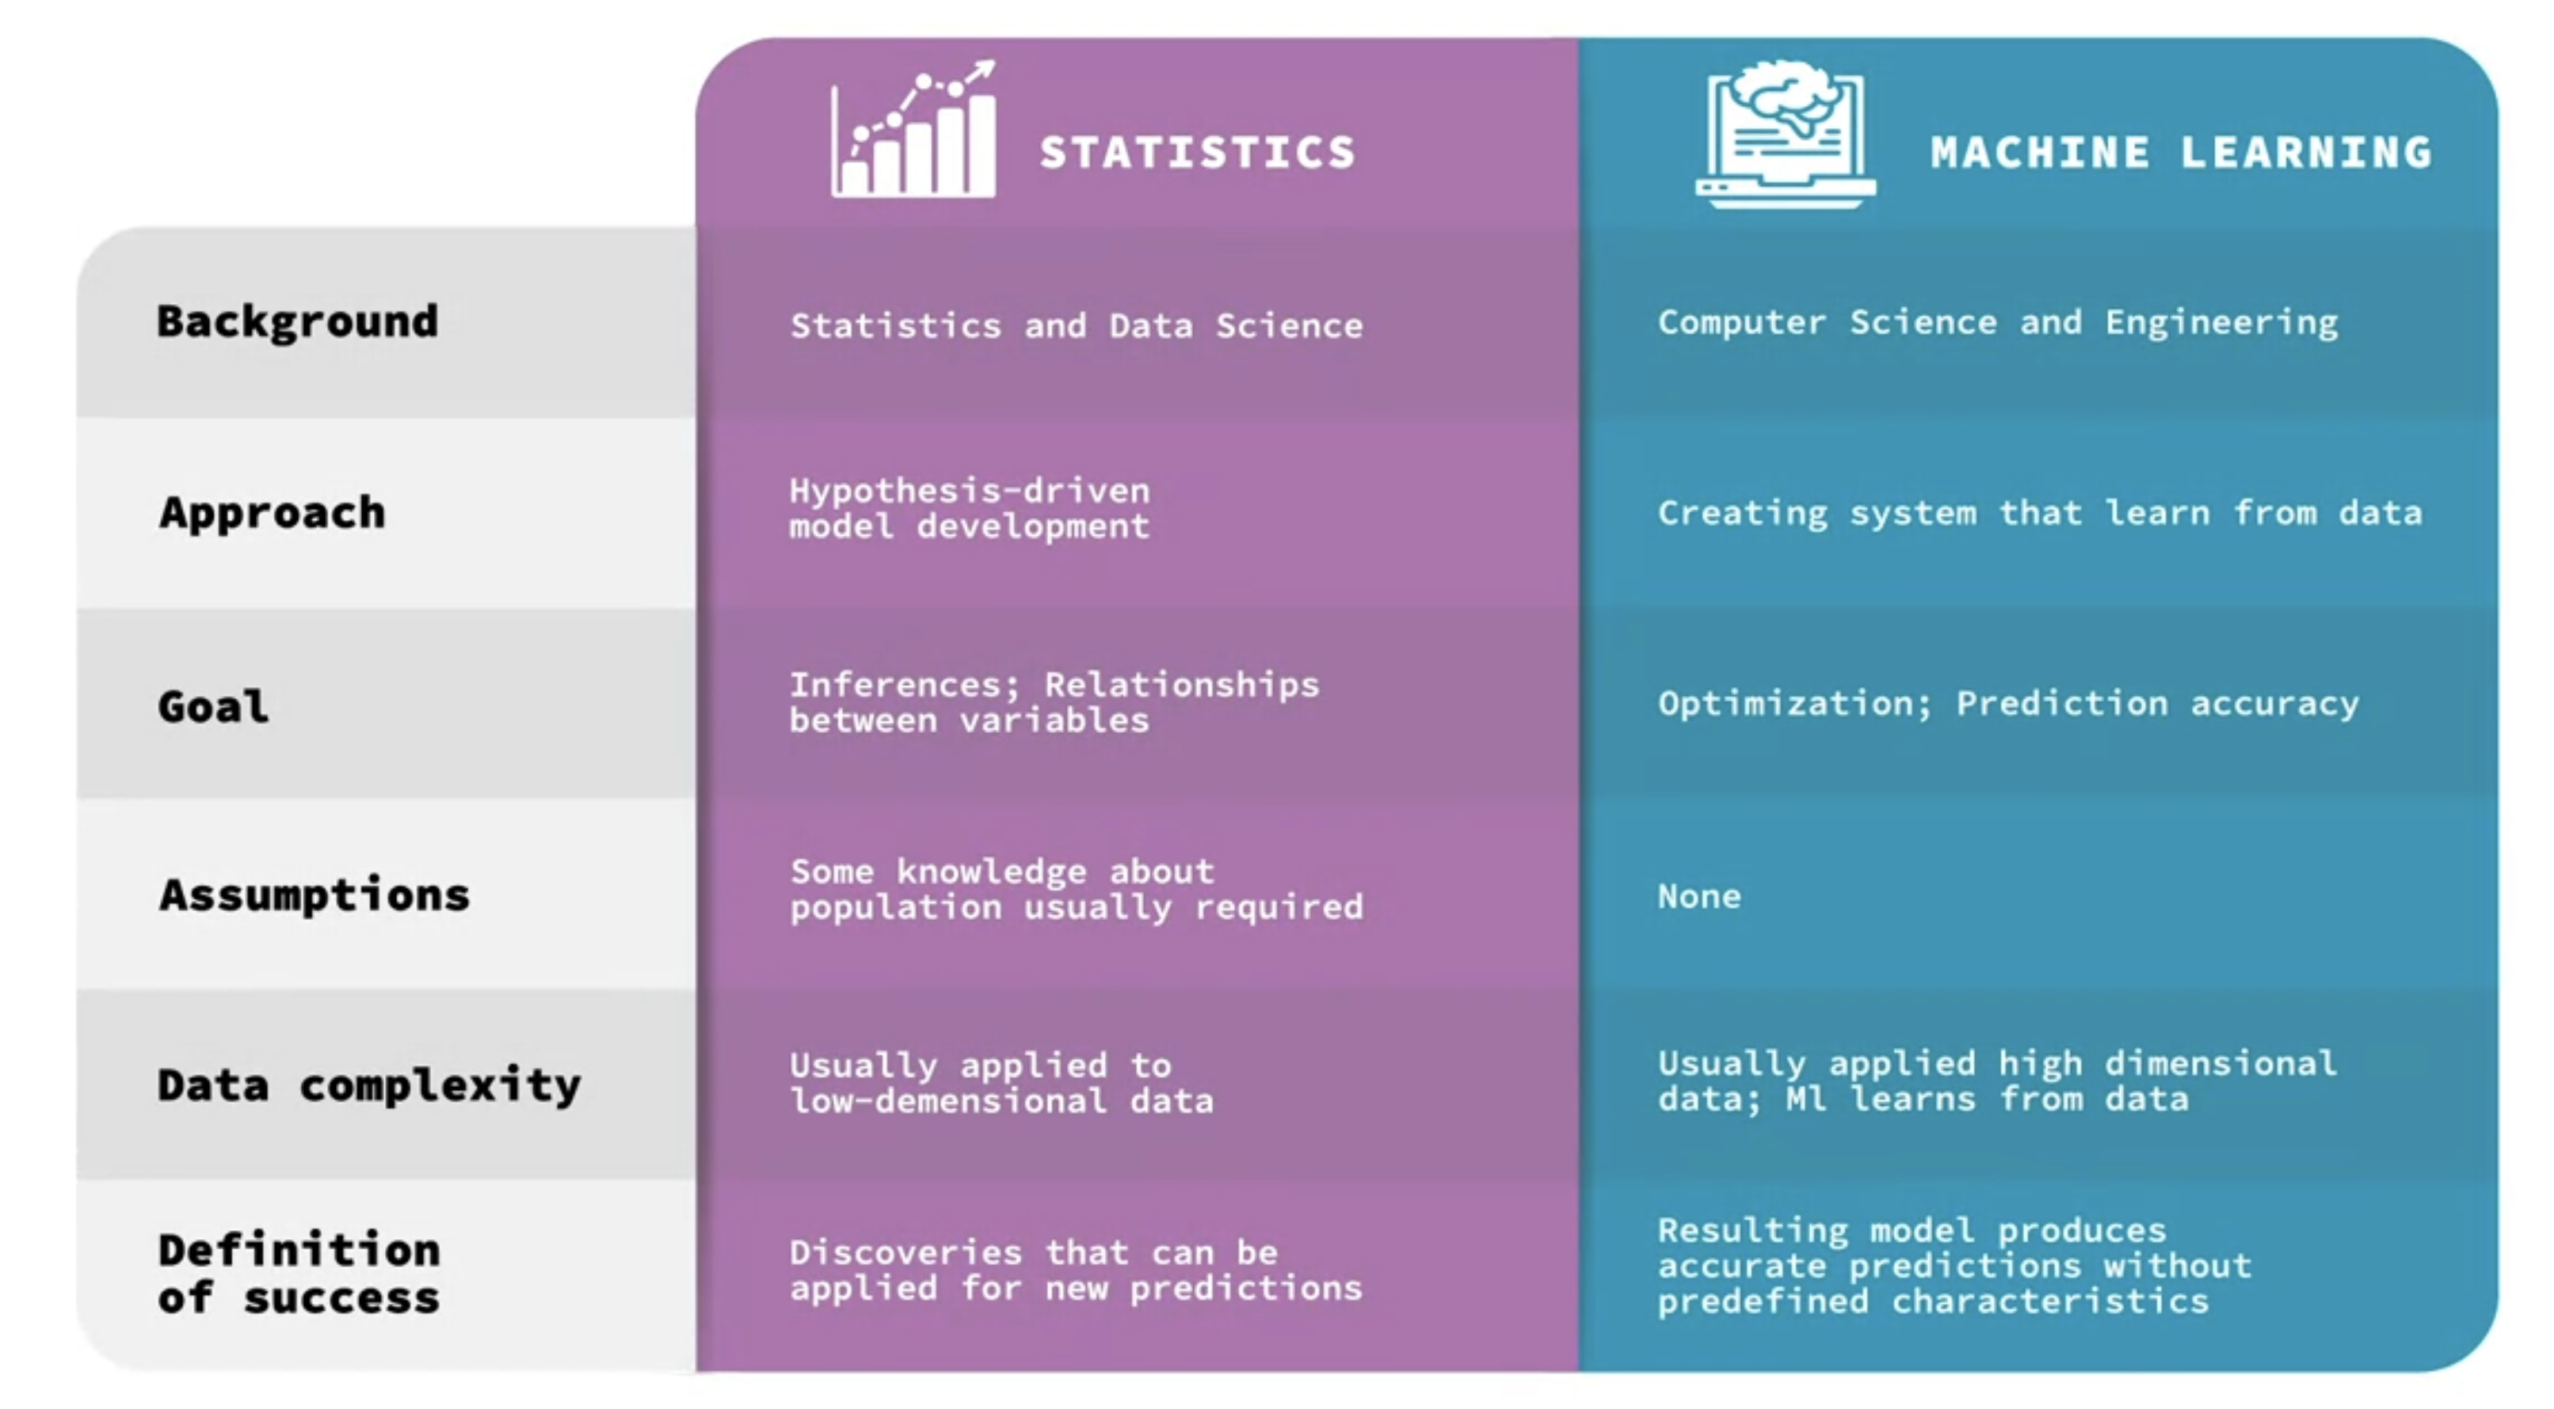
Notes:
How?
Biostatistics typically uses a hypothesis-driven approach by performing statistical modelling on a sample of a larger dataset that contains the population of interest and making various assumptions. The goal is to learn insights from the data that can inform building models.

Slide 19
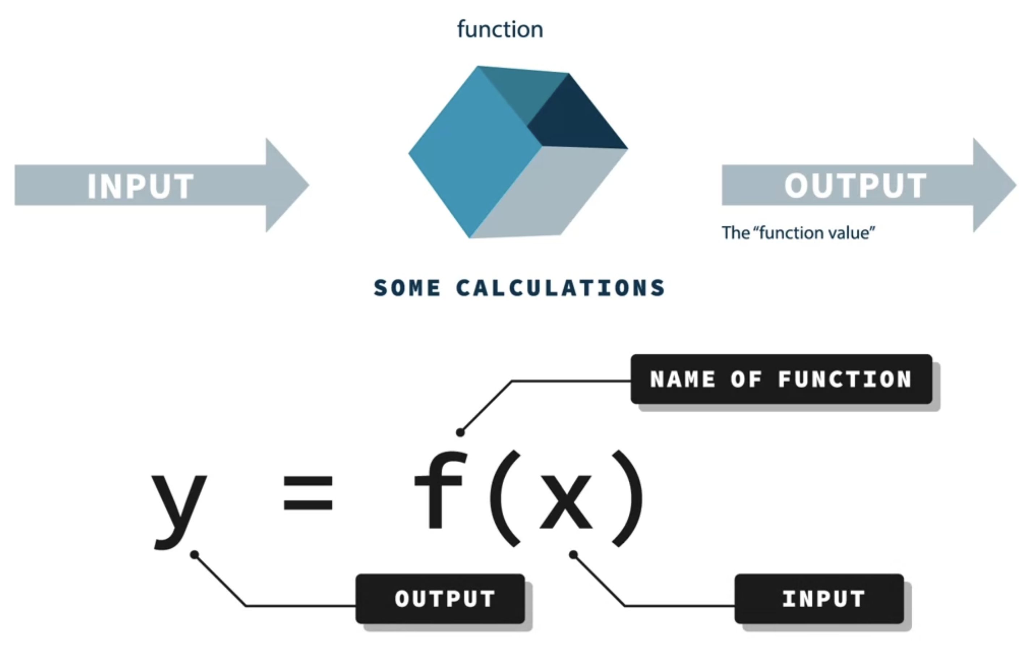
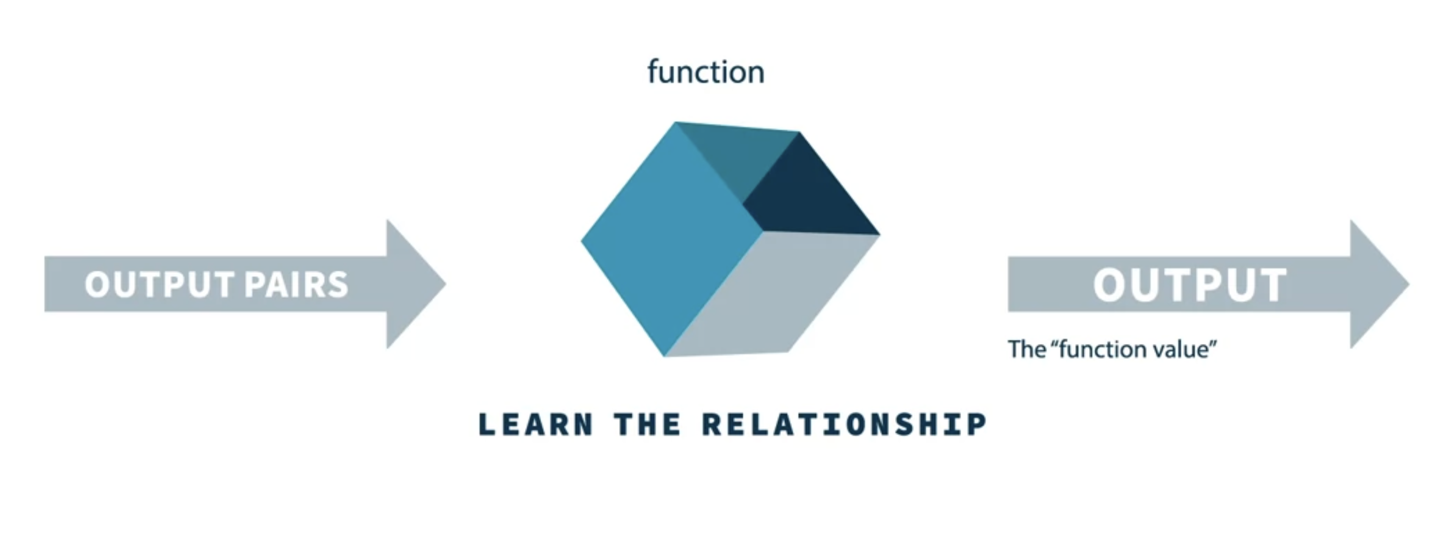
Notes:
Traditional programming refers to a function that is written by a human programmer to solve a problem, machine learning models, learn the function from the examples of inputs and corresponding desired outputs. When applied correctly, machine learning models can effectively learn all these components of a function that would have had to be coded by someone, just by leveraging existing data. It can then produce reliable, repeatable predictions, and decisions as output.
The model would use these data and outcomes or output pairs to learn the relationship between the data and the output label automatically.
It will learn to assign the proper values and calculations based on the data at a scene, without needing a human to explicitly program rules, to explain the relationship. To put this another way, a dataset with the correct answer would be fed into the system in such a way that over time and many examples, the feedback leads to a model that learns the important features automatically, and generates the desired output. The end result or goal, an automated diagnosis of abdominal pain in this example would appear the same.
There's a lot of overlap here. And machine learning has elements of both biostatistics in computer programming as well. The more useful aspects of machine learning that stand out include the fact that extremely large data sets can be accommodated and learned, perhaps beyond a human programmer or expert biostatisticians capacity to process.
And similar to biostatistics, there's an opportunity to discover exactly which variables out of the many that are used as input are most important for the models decision on and out output. And this can lead to new models and underpins countless studies mining healthcare data for causal relationships. it's really just the application of a mathematical formulation to a data problem
The important thing is just to recognize that a very big advantage of machine learning, broadly speaking, is that a computer model can be created using data to identify important features and obviate the need for upfront, a priori data analysis, or painstaking and time consuming rules based programming.

Slide 20
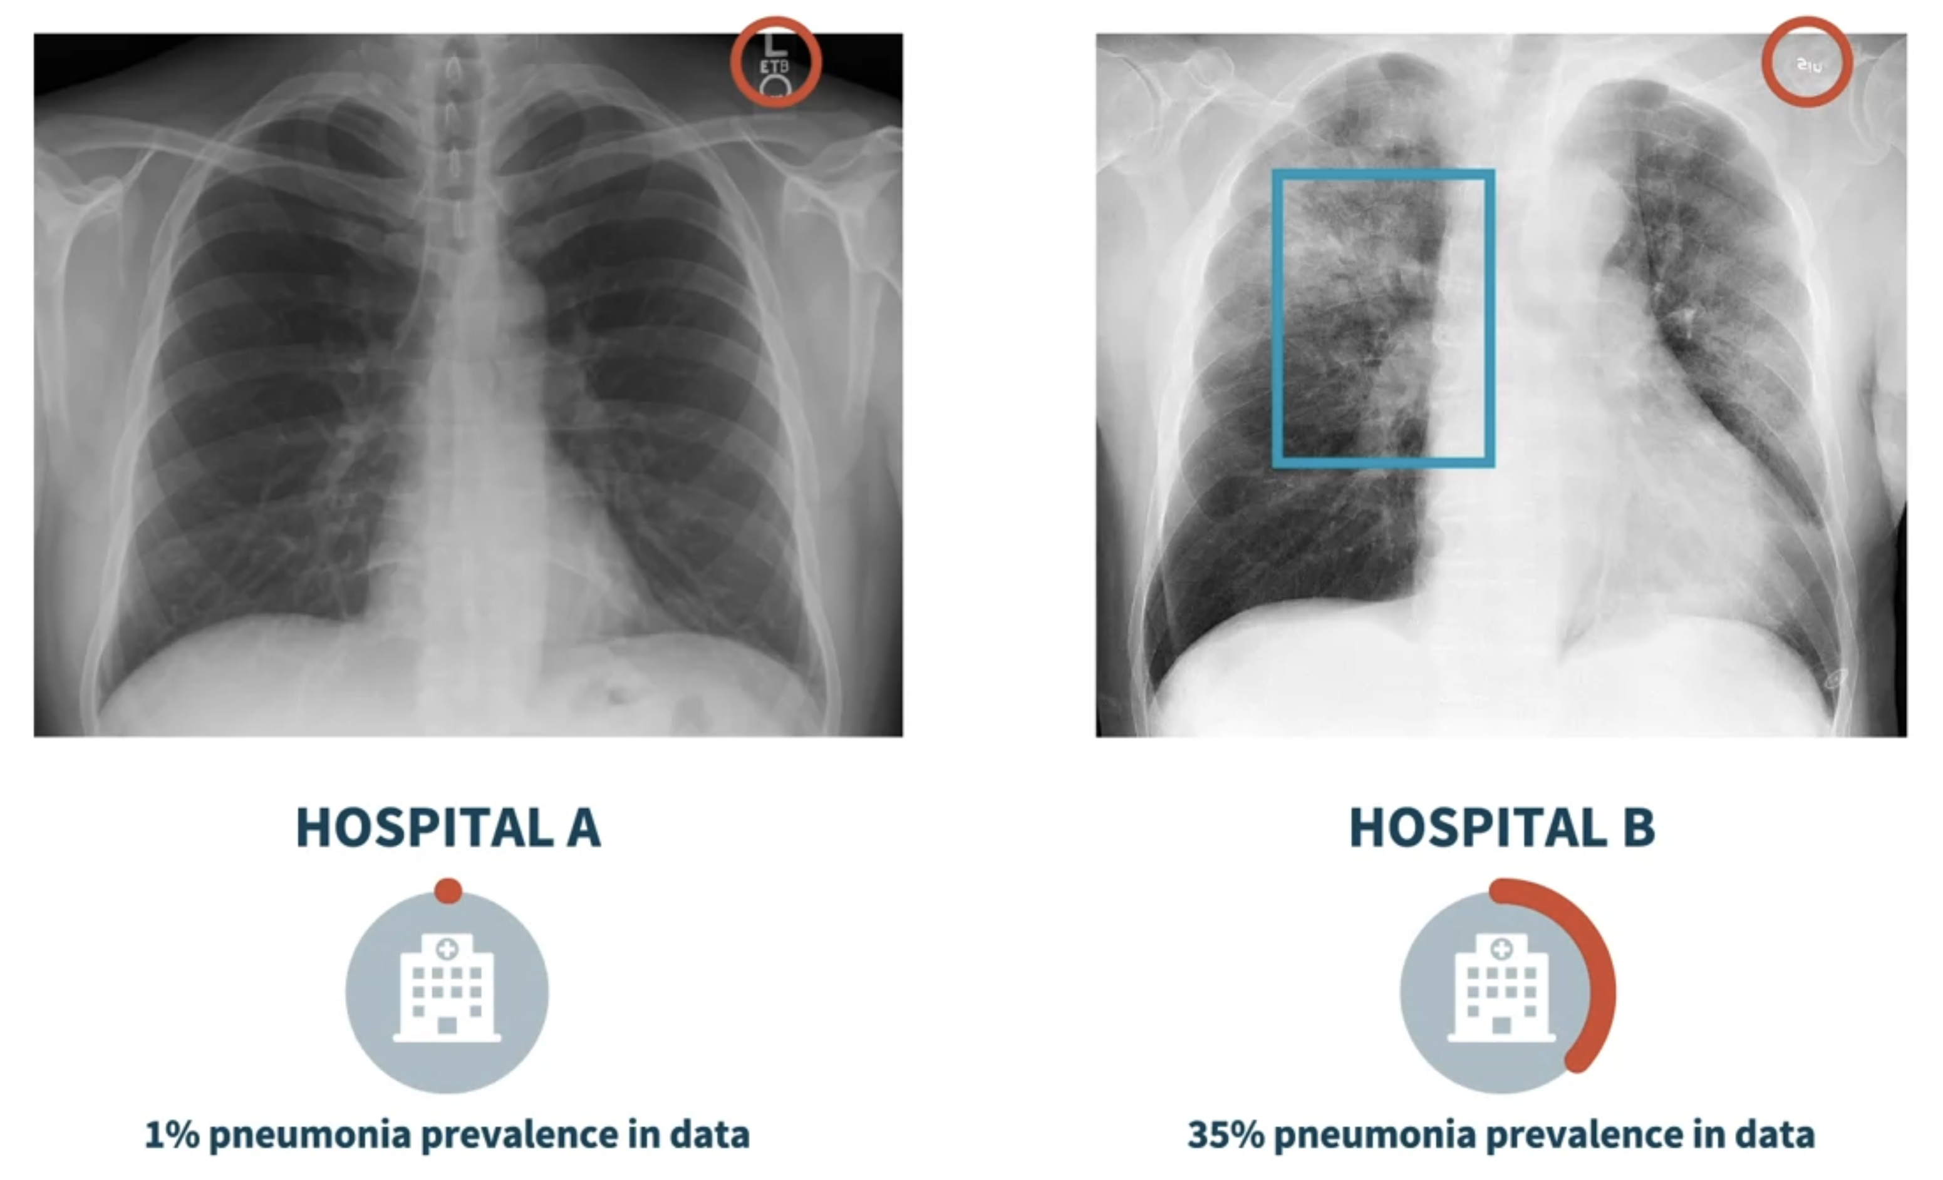

Slide 21
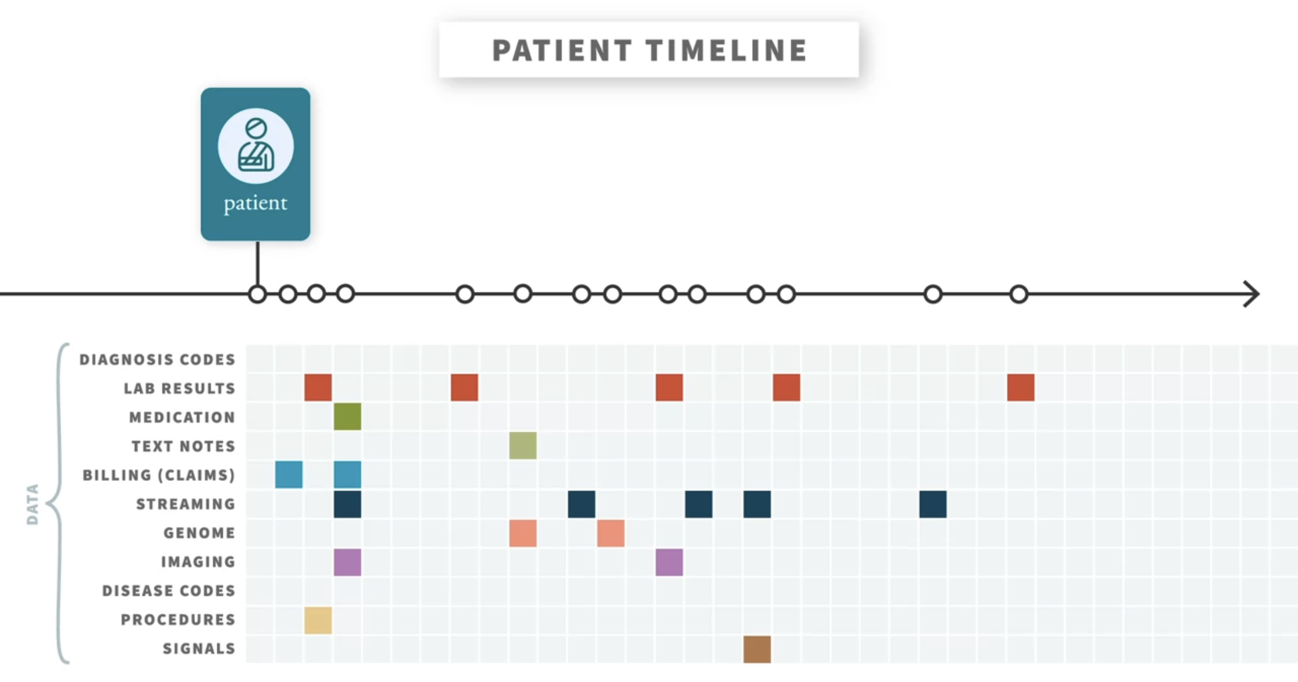
Notes:
Medical data is messy. It's generated often in a discontinuous timeline that is also plagued by disjointed, missing, and otherwise fragmented heterogeneous systems.

Slide 22
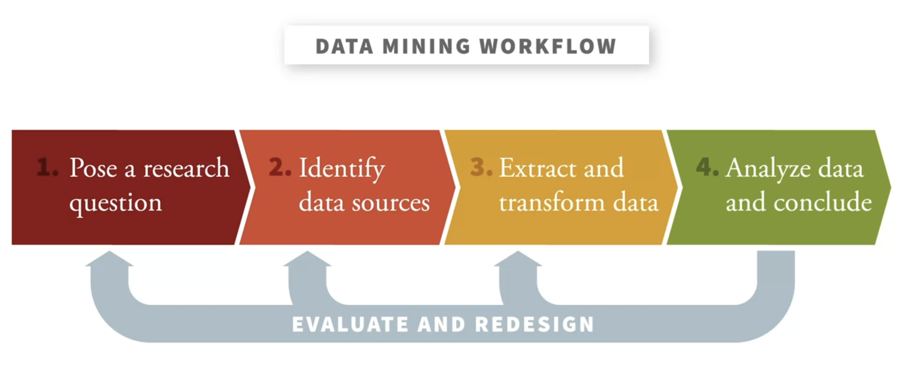
Notes:
bias

Slide 23
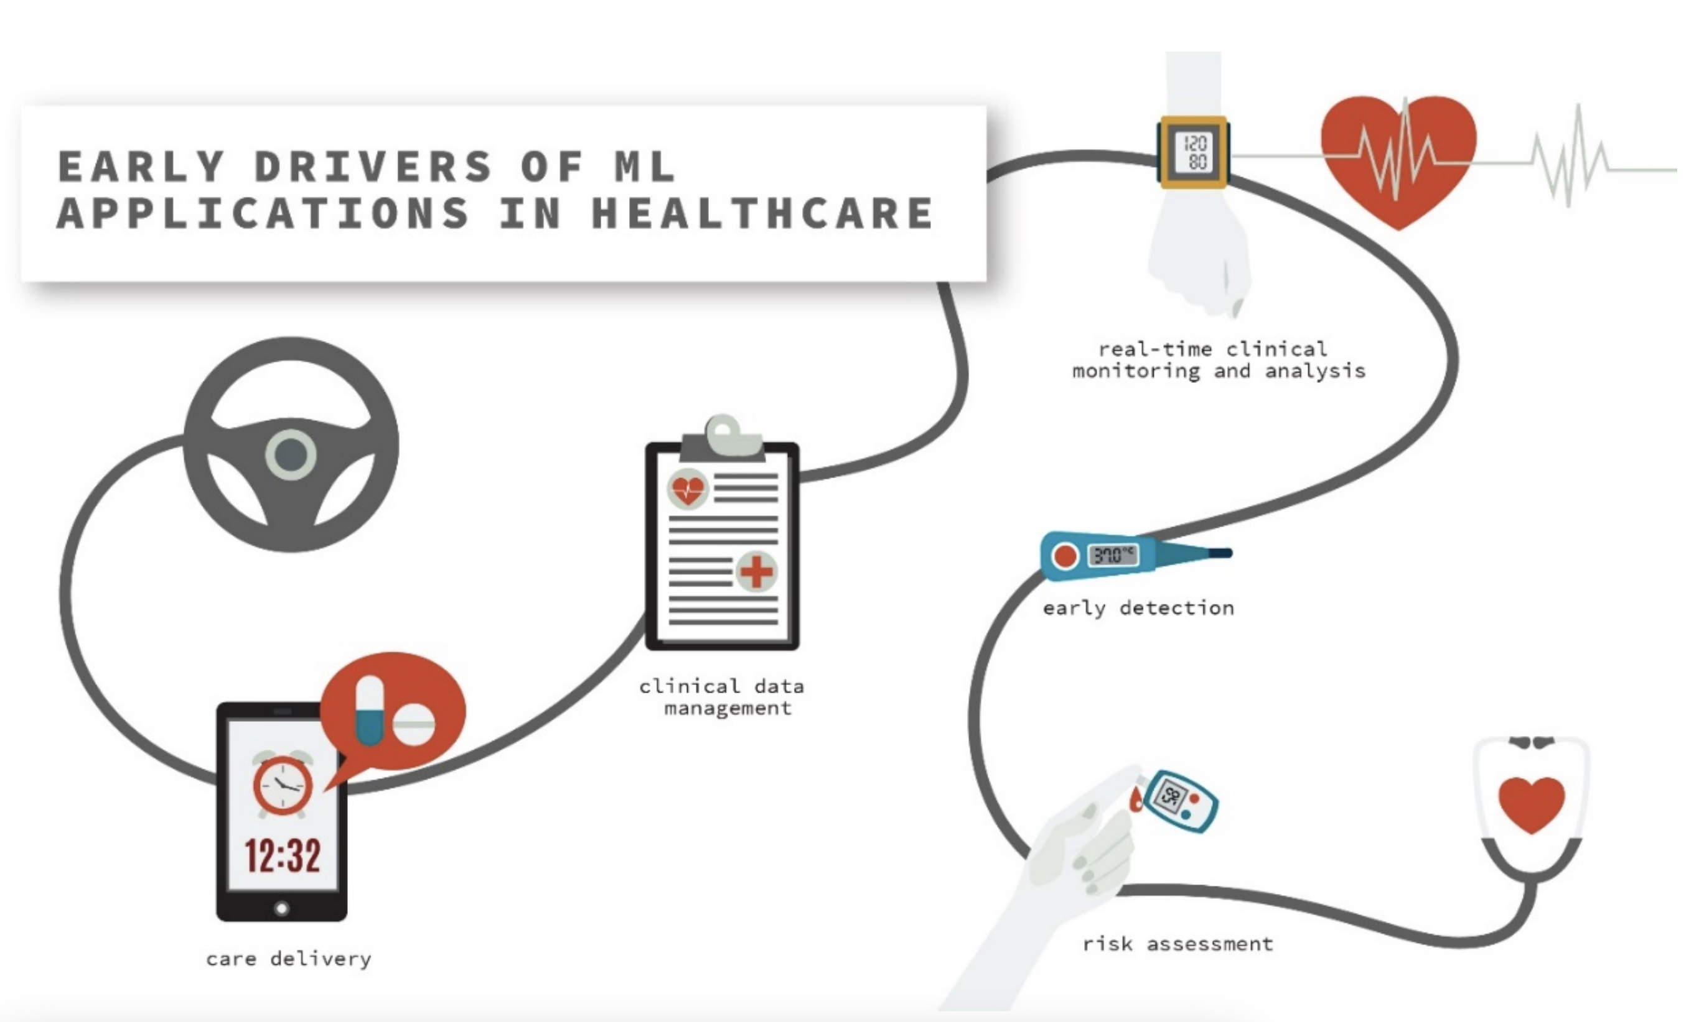
Notes:
bias

Slide 24
